Slide 1
Model adequacy
(and why AIC cannot tell you whether your model is any good)
Notes:
Framing for the whole lecture: model selection tells you which of your candidates fits best. It never tells you whether that winner is a good description of your data. Two separate questions; today we deal with the second one.

Slide 2
How we often choose a model
Write down a few candidate models
Fit each one to the data
Rank them with AIC — the lowest score wins
Nothing in this workflow ever asks whether the winning model is a good description of the data.
How would you even check?
Notes:
Walk through the three steps quickly — this is what they already do in their project work. Then land on the last two lines: at no point did anyone check that the winner is a sensible description of the data. Ask the room how they would check, and let them try before moving on.

Slide 3
Two different questions
Relative fit
Which of my candidate models fits best?
AIC, AICc, likelihood ratio tests. The answer is a ranking.
Absolute fit — model adequacy
Could this model have produced data like mine?
Simulate from the fitted model and compare. No other model is involved.
The two answers are independent. A model can win the ranking and still describe the data badly.
Notes:
The most important slide. Relative fit compares models with each other; absolute fit compares one model with the data. The second question does not involve the other candidates at all. Stress that the two answers are logically independent.

Slide 4
What AIC cannot do
It cannot reject all your candidates (one of them always comes first)
A large ΔAIC means “much better”, not “good”
It cannot see a pattern that none of your models has a name for
The winner is only the best of the list you wrote down
A race always has a winner.
That tells you nothing about whether anyone ran fast.
Notes:
The race analogy is the line to repeat later. The structural point: information criteria and likelihood ratio tests have no mechanism for rejecting all candidates at once, because they only ever compare.

Slide 5
Model adequacy
If a model describes my data well, then data simulated by that model should look like the data I actually have.
Fit the model to your data
Calculate a test statistic on your data
Simulate 1000 new datasets from the fitted model
Calculate the same test statistic on each of them
Is the observed value inside the middle 95% of the simulated ones?
Notes:
Step 2: a test statistic is just a number you can compute from a dataset — a correlation, a slope, a count. Step 5 is the whole logic: your data are one dataset, the model tells you what a thousand of its own datasets look like, and if yours is an outlier among them the model does not produce data like yours. If it falls outside, the model fails that test.

Slide 6
A toy example: shoe size and height
Notes:
Deliberately not palaeontological — the logic is completely general.

Slide 7
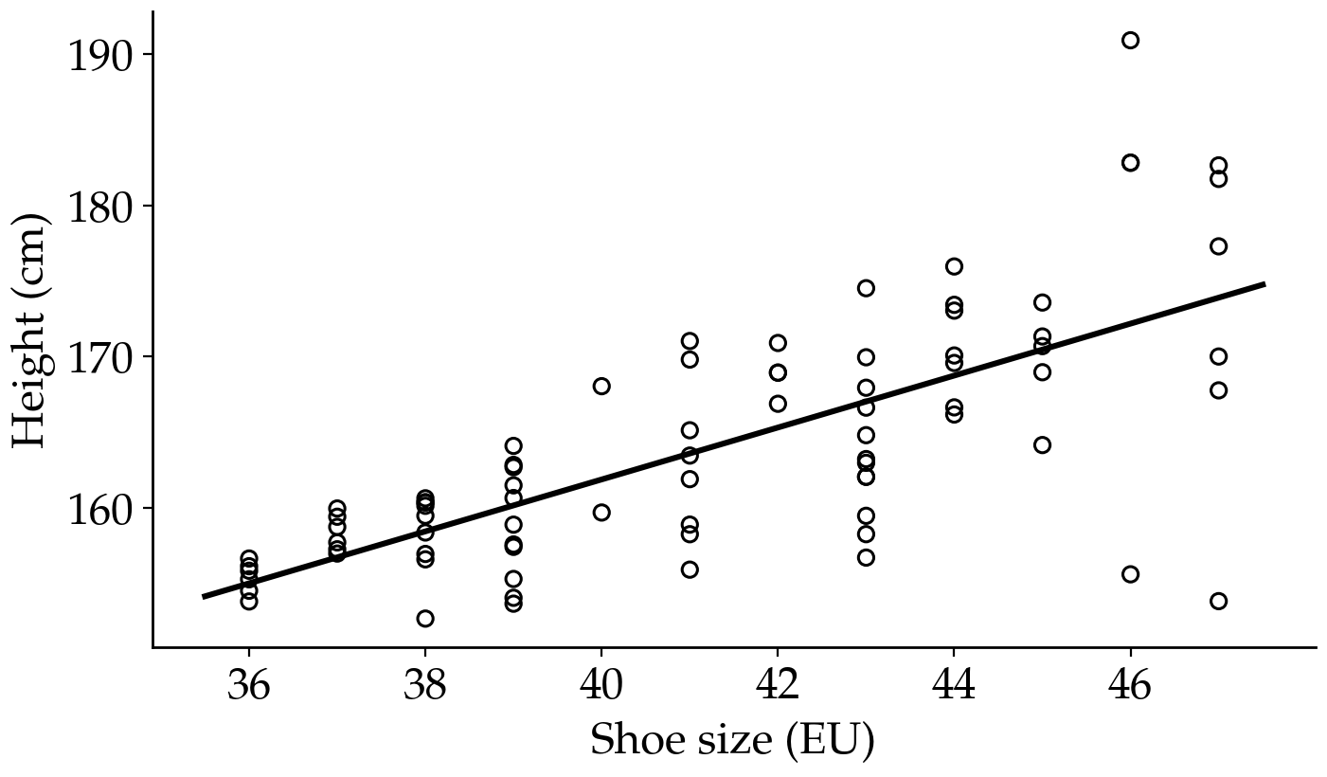
80 students: shoe size and height
Three candidate models:
A. No relationship
B. A straight line
C. A curve
All three assume the noise is normal, and the same size for everybody.
Notes:
Point at the last line and plant the seed: every candidate makes the same constant-noise assumption, so no amount of model comparison between them can ever catch a problem with it.

Slide 8
AIC picks the straight line
Model
AICc
ΔAICc
Akaike weight
A. No relationship
564.4
53.9
0.00
B. A straight line
510.5
0.0
0.71
C. A curve
512.4
1.8
0.29
height ≈ 93 + 1.7 × shoe size, residual SD ≈ 5.7 cm
This is where most analyses stop.
So: is model B a good description of these 80 students?
Notes:
ΔAICc of 53.9 for model A is enormous — nobody would defend it. Between B and C the difference is small and the extra parameter is not worth it. The winner looks convincing. Pause on the last line.

Slide 9
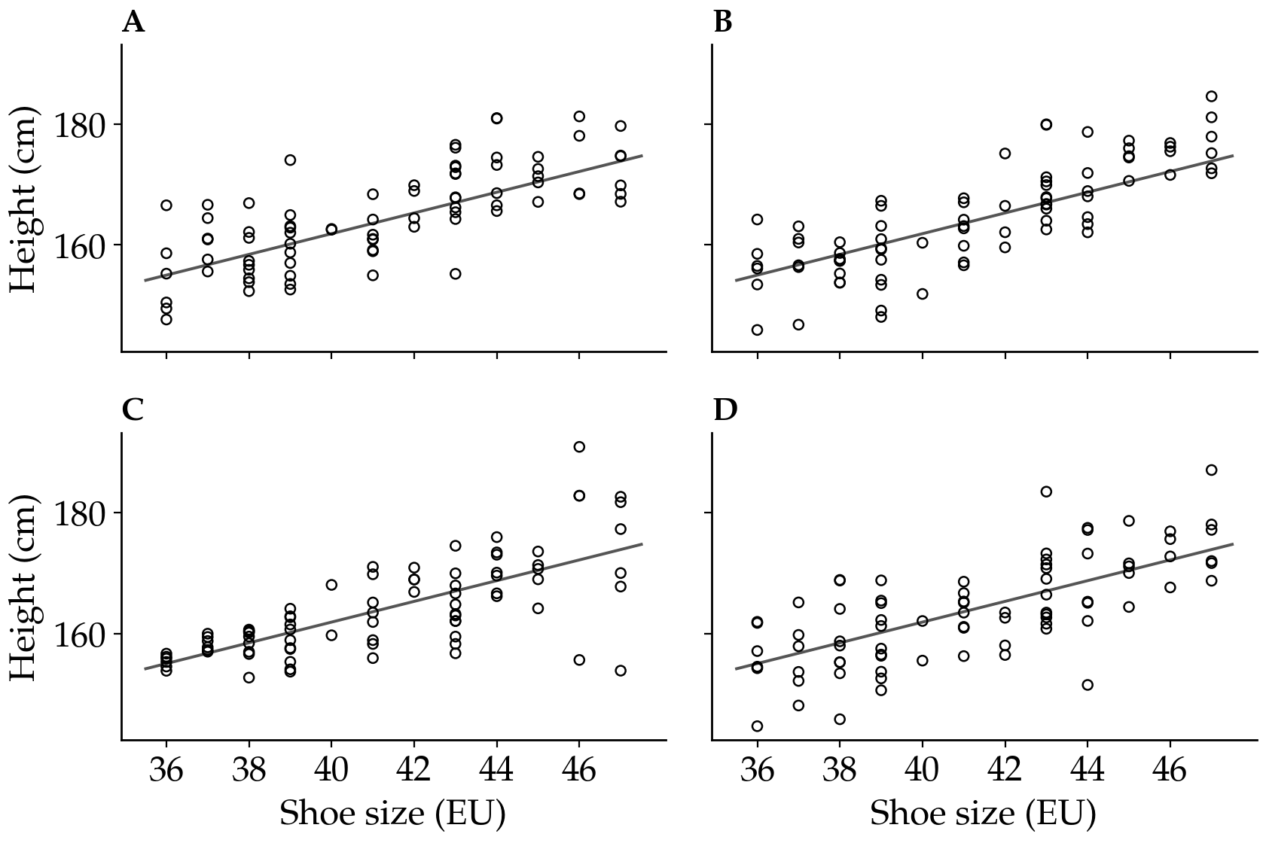
Let the winning model make some data
Three of these four panels were generated by the fitted model B. One is the real 80 students.
Which one is real?
Notes:
Let them look for 20-30 seconds before saying anything. Some will spot it, some will not — that is the point: eyeballing works sometimes but is unreliable, which is why we turn the comparison into a number.

Slide 10
Let the winning model make some data
Three of these four panels were generated by the fitted model B. One is the real 80 students.
Which one is real?
Panel C. In the real data the small-footed students sit tightly around the line and the large-footed ones scatter widely.
Notes:
Let them look for 20-30 seconds before saying anything. Some will spot it, some will not — that is the point: eyeballing works sometimes but is unreliable, which is why we turn the comparison into a number.

Slide 11
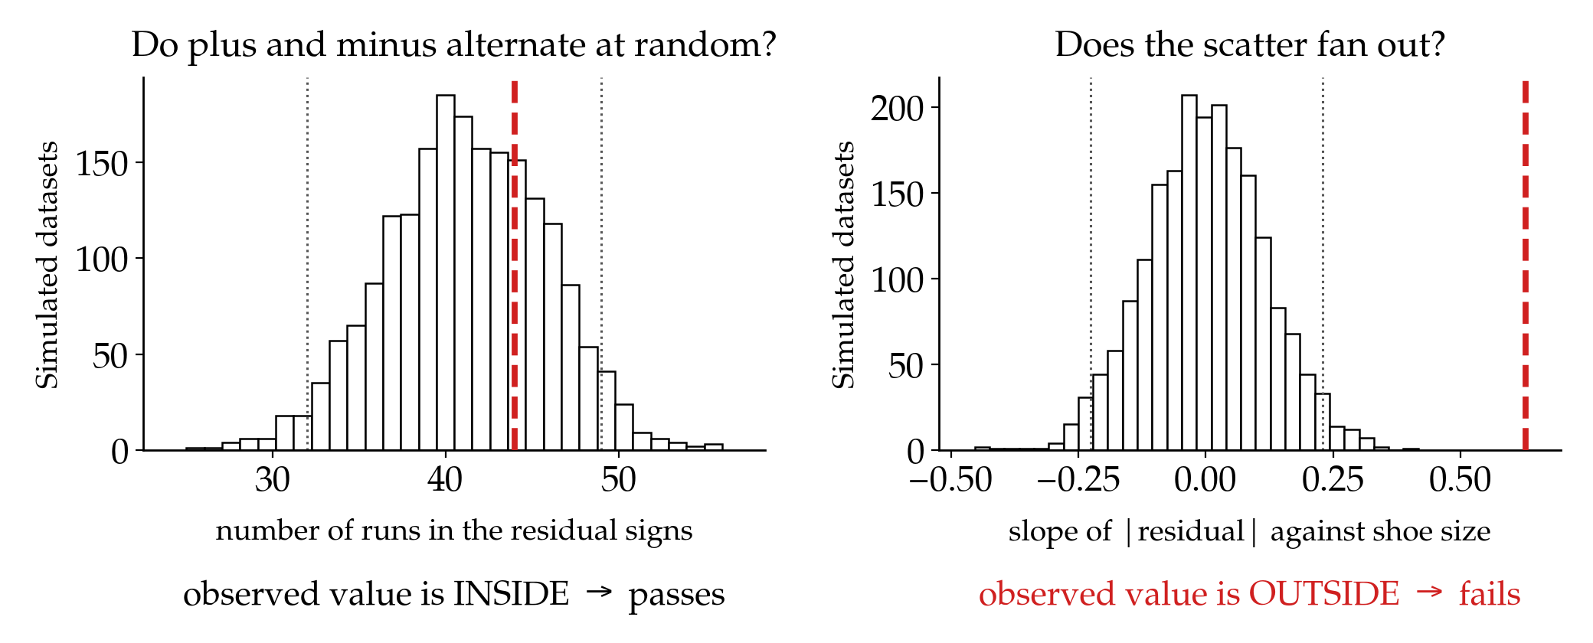
Two test statistics, one verdict
2000 datasets simulated by model B. Dotted lines: the middle 95%. Red: our real students.
Model B is not an adequate description of these data, and comparing it with A and C could never have told us that.
Notes:
Left: are the plus and minus residuals in random order? Observed 44 runs; the model produces 32-49. Passes. Right: does the spread grow with shoe size? Observed slope 0.63; the model essentially never produces anything above 0.23. Fails badly. Say the consequence out loud: the single residual SD of 5.7 cm we would have reported describes nobody — far too wide for size 36, far too narrow for size 47. Failing one test is enough.

Slide 12
Back to the fossil record
Notes:
Same logic, same problem, different data.

Slide 13
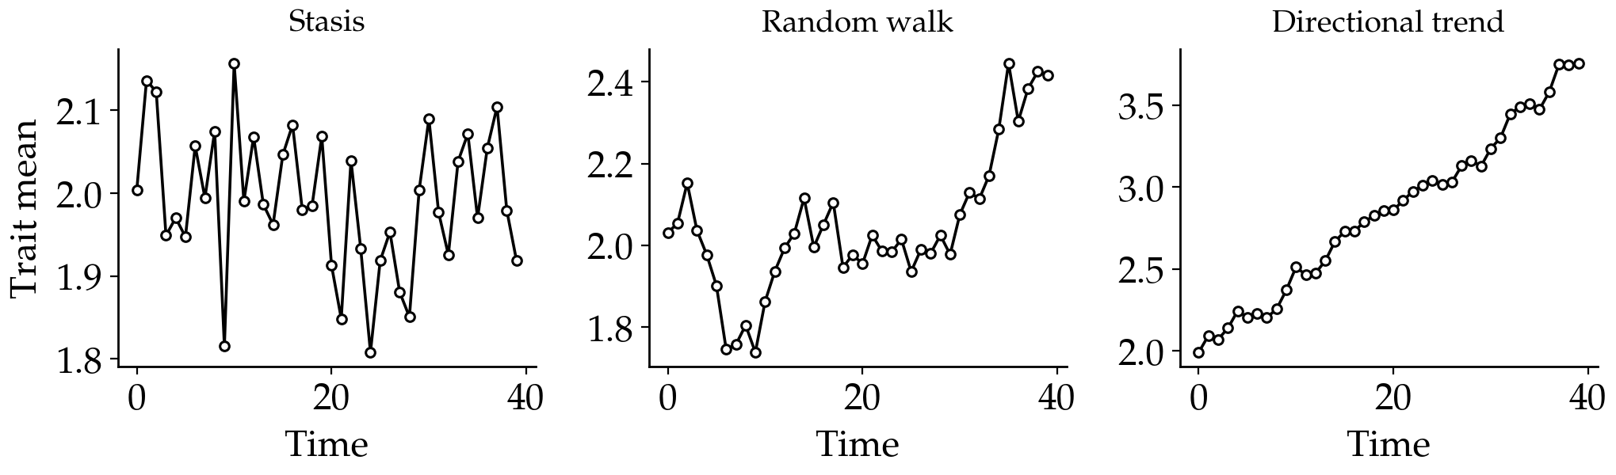
Three models of phyletic evolution
Stasis — fluctuation around a fixed optimum θ with variance ω. White noise.
Random walk — steps drawn from a normal distribution with mean zero, variance vstep.
Directional trend — the same, but the step distribution has a non-zero mean mstep.
Notes:
Keep this short. Palaeontologists face the identical situation: three candidate models, an AICc ranking, and parameters — rates of evolution — that people then interpret biologically. Those rate estimates are only meaningful if the model actually describes the trait dynamics.

Slide 14
Four adequacy tests in adePEM
Autocorrelation — is each observation correlated with the next one?
Runs — are the signs of the deviations in random order, or in long streaks?
Fixed variance — do the deviations grow or shrink through time?
Net evolution — is the net change small? (stasis only)
All four assume white noise, which is what stasis looks like. Random-walk and trend data are detrended first, so the same tests apply to all three models.
Voje (2018), table 1. R package adePEM: fit3adequacy.stasis(), fit3adequacy.RW(), fit3adequacy.trend()
Notes:
Do not dwell on the maths. What matters is that each statistic captures a feature the model has a commitment to, and each is compared against 1000 simulations exactly as in the shoe-size example. The net evolution test is the one that encodes the verbal definition of stasis: little net change.

Slide 15
Take home
Model selection ranks. Model adequacy validates. Do both.
AIC always hands you a winner, even when every candidate is poor.
Adequacy asks one question, and answers it by simulation.
Rates, ω and other parameters mean something only if the model is adequate.
It is not all-or-nothing: a failed test tells you which assumption the data violate.
Voje, K. L. (2018) Assessing adequacy of models of phyletic evolution in the fossil record. Methods in Ecology and Evolution.
Voje, K. L., Starrfelt, J. & Liow, L. H. (2018) Model adequacy and microevolutionary explanations for stasis in the fossil record. The American Naturalist 191, 509–523.
R package adePEM: github.com/klvoje/adePEM
Notes:
Close on point 5. Model adequacy is not a gatekeeping ritual: it tells you which assumptions your data break, and you decide whether that matters for the inference you want to make. An adequate model is also not a true model — it only means the data do not violate the specific properties you tested.

